Slide 1

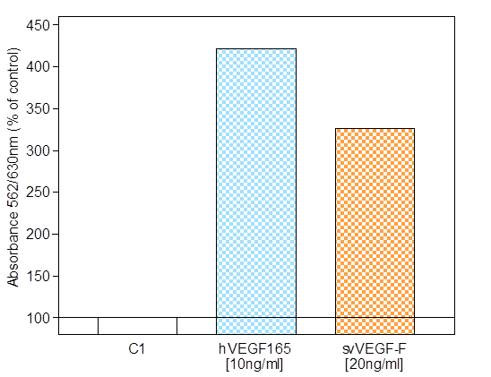
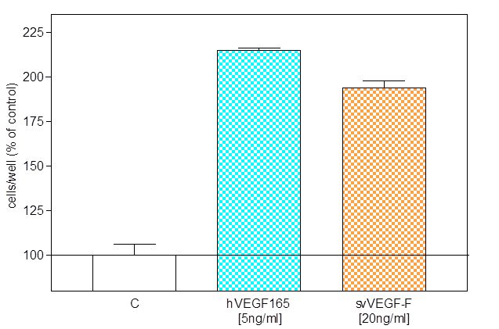
ReliaTech GmbH
Recombinant Snake venom VEGF-F (svVEGF-F) derived from E. coli
(Cat #300-096S/-096/-097)
Migration assay with HUVEC P4
Proliferation assay with HUVEC P4
http://www.reliatech.de / orders@reliatech.de

